Slide 1

Artificial Intelligence for Business Decisions and Transformation
CSCN8030 - Spring 2024 - Section 2
Sprint 4 - Design
July 5, 2024
Group 4 - Members:
Krishna Kumar, Hemasree
Shijin, Jency
Fernandez, Arcadio
Professor:
Glaucia Melo dos Santos, PhD

Slide 2
Agenda
1. Group members role
2. Sprint Case : Loblaws Digital
3. Loblaws Digital
4. Project Pitch
5. Sprint Planning

Slide 3


1. Group members role
Product owner
Developers
Arcadio
Hema
Jency
Connects with the customer
Contributes to the vision and roadmap
Manages and prioritizes the team backlog
Supports the team in delivering value
Continuously evolves product design
Implements the vision and roadmap
Works on the team backlog
Builds, tests, and delivers increments of value

Slide 4
2. Sprint Case : Loblaws Digital
Loblaws Digital wants to know the customers who are going to attrit, so accordingly, and strategies that would work to keep them loyal to Loblaws. You are a Data Scientist, hired by Loblaws Digital to help them predict customer attrition and determine strategies that were sure to work to improve retention. Their Product Mangers have been able to provide you with some data from the last month to help you make get started.
Goal
1. Build a predictive model that can accurately identify customers who are at risk of leaving the company (churn) based on the provided variables.
This can help the company take proactive steps to retain these customers and reduce the rate of churn.
2. Perform a thorough exploratory analysis of the provided customer data to gain insights into the behavior and characteristics of the customers. This includes analyzing patterns and trends in variables. This analysis can help the company understand its customers better and inform future decision-making.
https://www.loblawdigital.co/our-work/

Slide 5
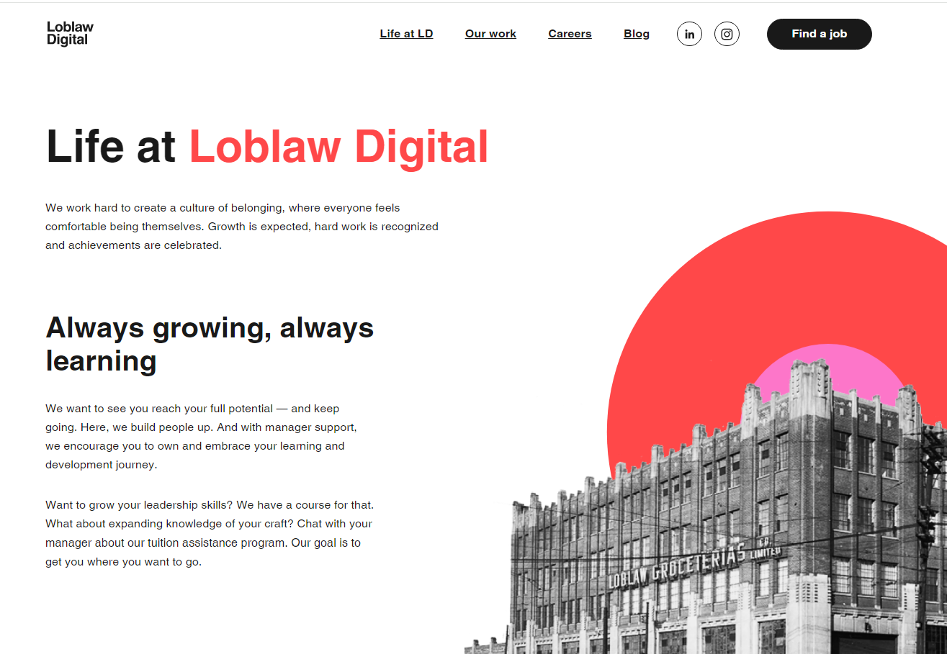
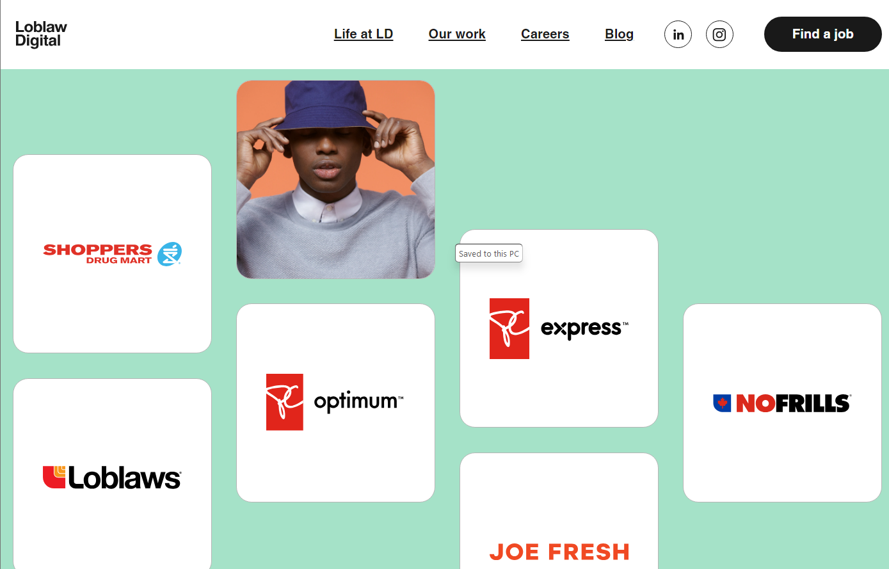
3. Loblaws Digital
https://loblawdigital.co/life-at-ld/

Slide 6
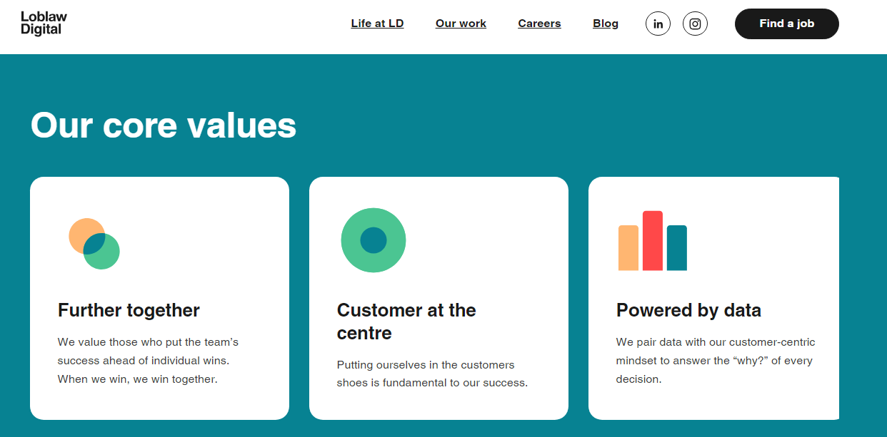
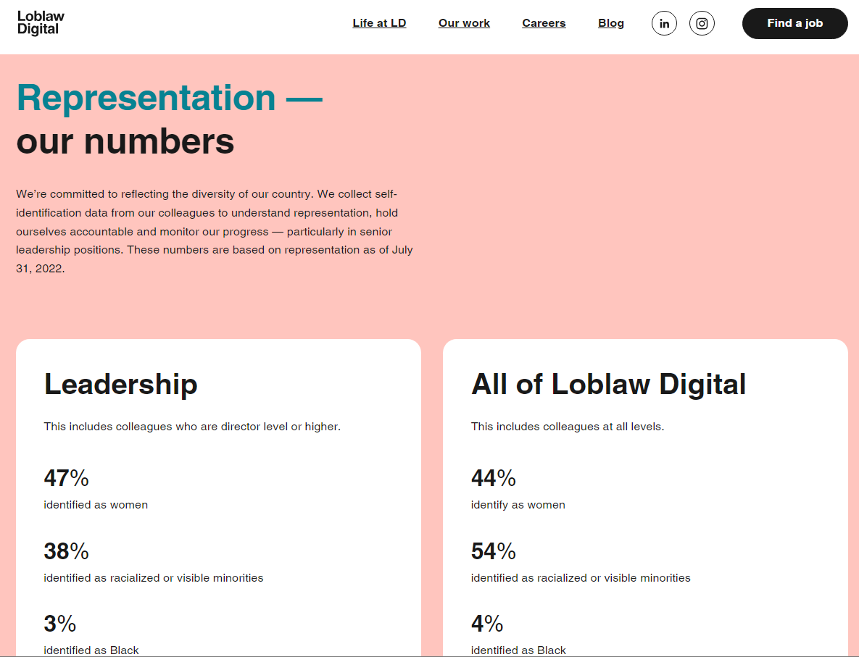
3. Loblaws Digital
https://loblawdigital.co/life-at-ld/

Slide 7
4. Project Pitch
Loblaws Digital - predict customer attrition and determine strategies
Project Pitch | BUSINESS
Organization or Category | Digital businesses
Description of Organization | Loblaws Digital - design, build, operate and evolve digital experiences for some of Canada’s biggest brands. It focuses on eCommerce, loyalty, and digital innovation across various sectors including grocery, fashion, loyalty programs, and health and beauty. The organization is dedicated to creating best-in-class digital experiences through research and data-driven decisions.
Two Specific Ethical Considerations in AI Adoption | Data Privacy and Security: Ensuring customer data is protected and used ethically, with clear consent and robust security measures to prevent unauthorized access. Bias and Fairness: Developing AI models that are fair and unbiased, ensuring that predictions and decisions do not discriminate against any group of customers.

Slide 8
4. Project Pitch
Loblaws Digital - predict customer attrition and determine strategies
Three Examples of Operational Decisions | Daily Inventory Management: Adjust inventory levels based on predicted customer retention to avoid overstocking or stockouts. Customer Support Responses: Using AI to triage and respond to customer service inquiries quickly and accurately. Personalized Recommendations: Implementing algorithms that provide personalized product recommendations to customers based on their shopping history.
Three Examples of Tactical Decisions | Marketing Campaign Adjustments: Modifying marketing strategies based on performance data and customer behavior insights. Pricing Strategies: Adjusting prices dynamically based on competitor analysis and market demand. Loyalty Program Enhancements: Refining the PC Optimum™ program to better reward and engage customers based on their preferences and shopping habits.
Three Examples of Strategic Decisions | Expansion into New Markets: Identify regions with lower attrition rates and consider expanding operations in those areas. Customer-Centric Strategy: Shift focus towards a more customer-centric business strategy by using insights from attrition predictions. Long-term Customer Retention Strategies: Formulating comprehensive strategies to increase customer loyalty and reduce churn over the long term.

Slide 9
4. Project Pitch
Loblaws Digital - predict customer attrition and determine strategies
Why this is topic important? | This topic is crucial because it addresses customer attrition, a significant challenge for businesses. Predicting and preventing customer churn can significantly enhance a company's profitability and sustainability. By understanding and addressing the reasons behind customer churn, businesses can improve their products and services, leading to higher customer satisfaction and loyalty.
How could this project make an impact outside of class? | This project can serve as a case study for other companies facing similar challenges, providing insights and methodologies that can be applied to improve customer retention. It can also contribute to the field of data science by showcasing the application of predictive analytics and machine learning in real-world business problems.
Why should class choose this topic? | The class should choose this topic because it combines theoretical knowledge with practical application, allowing students to work on a real-world problem that has significant business implications. It provides an opportunity to develop skills in data analysis, machine learning, and strategic decision-making, which are highly valuable in today's job market.

Slide 10
5. Sprint Planning
Tasks | Owner | Priority | Sprint | Story Points | Estimated Effort in Hours
1. Perform statistical analysis, such as counts, averages, and distributions to provide insights to predict customer attrition and determine strategies that were sure to work to improve retention | Jency | med | 4 | 3 | 1
2. Perform a thorough exploratory analysis of the provided customer data to gain insights into the behavior and characteristics of the customers. This includes analyzing patterns and trends in variables | Jency | med | 4 | 3 | 1
3. Check for missing values in the dataset and decide on strategies to handle them such as imputation or removal. | Jency | med | 4 | 5 | 1
4. Encode categorical variables into numerical format using techniques like one-hot encoding or label encoding. | Jency | high | 4 | 3 | 1
5. Scale numerical features to ensure they have similar ranges, which can improve the performance of ML algorithm. | Arcadio | med | 4 | 3 | 1
6. Identify which features are most relevant for predicting customer attrition and determine strategies that were sure to work to improve retention | Arcadio | high | 4 | 3 | 1
7. Create new features from existing ones that might improve model performance. | Arcadio | med | 4 | 5 | 1
8. Choose appropriate machine learning algorithms for customer attrition. | Arcadio | high | 4 | 5 | 2
9. Experiment with different models and train the selected models on the training data. Tune hyperparameters using techniques like grid search | Hema | med | 4 | 3 | 3
10. Evaluate the trained models on the testing data to assess and compare their performance using evaluation metrics like accuracy, precision, recall, F1-score, and area under the ROC curve (AUC-ROC). | Hema | high | 4 | 5 | 3
11. Deploy the ML model to make predictions on new, unseen data. | Hema | high | 4 | 5 | 2
12. Design a user interface (UI) for interacting with a machine learning model built to predict customer attrition. | Hema | med | 4 | 3 | 3

